Slide 1
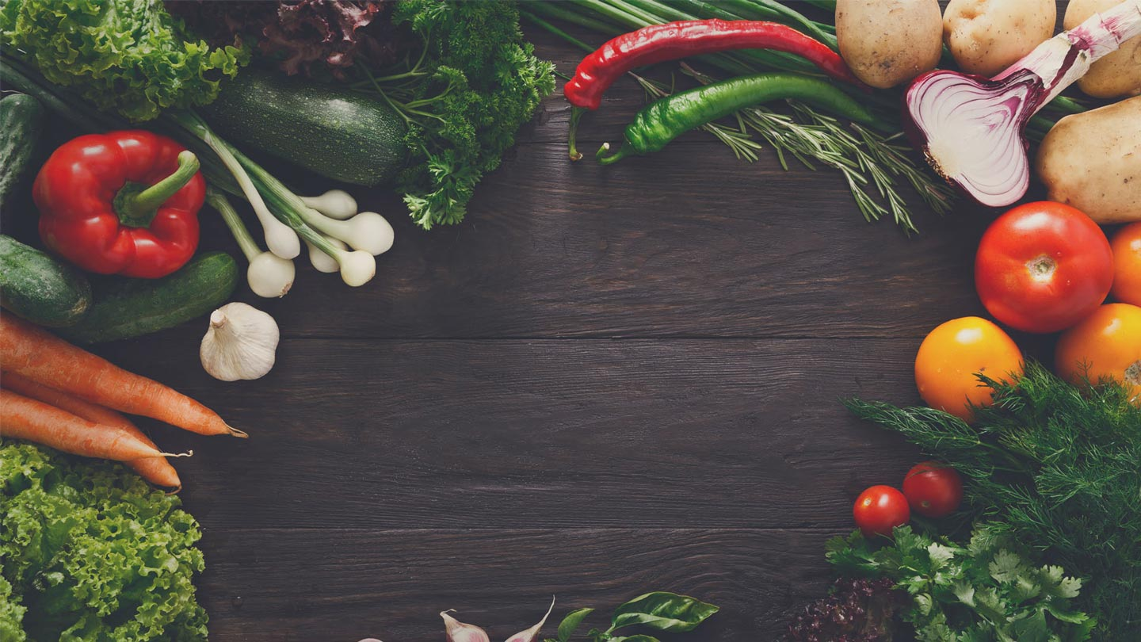


WELCOME

Slide 2

$ 3.1 Billon USD
?
Notes:
Lets Talk about Agriculture, and what it means for this country.
Regionally, Do you know, Agriculture is the least talked about dream profession? When last you hear a child, or teen say, I wanna be a farmer when I grow up? The import bill is doubled that figure, but this is for specifically for agriculture produce, it

Slide 3
Notes:
The orange part represents the amount of agro products that are imported, compared to Guyana’s ENTIRE net worth

Slide 4
Excerpts from Farmers
Excerpts from Farmers
57-year -old
Donald ‘Ganga’ Rampersaud
57-year -old
Donald ‘Ganga’ Rampersaud
‘The man who has to provide 51 meals a day for his family’.
Notes:
Ganga is a small scale farmer based in Wakenaam who sells bananas, well, he’s trying to, one of his comments were ..
Farmer’s like Ganga, our Methodology is based on…. We want to assist farmers to not suffer the same faith as Ganga. We want to provide them with a platform that’s, easy to use, friendly, and one that is always at your side.
We understand farmer’s plight, we are going to deliver a solution to them that will assist them with their plight.

Slide 5
“small scale farmers are at the mercy of buyers.”

Slide 6

How we do what we do
Understand our users.
Build an application that’s simple, easy to use for our users.
Make our users Happy.

Slide 7
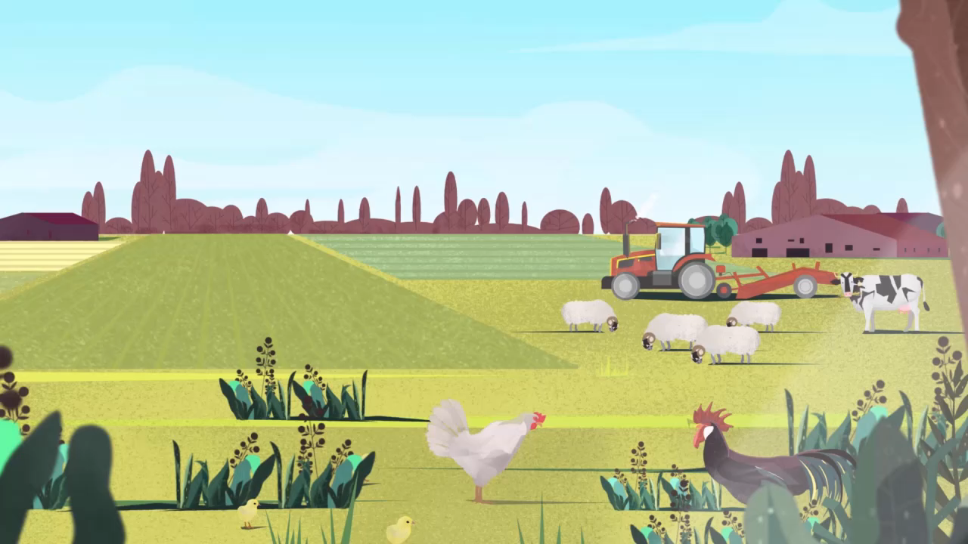

Slide 8
FARMERSMARKET.GY

Slide 9

FEATURES

Slide 10
Requirement 1: Match buyers and sellers of agricultural products(based on offer on both sides).
Notes:
We aimed to understand our end users
Farmersmarket.gy is built on the simplicity, while maximizing performance.

Slide 11
Requirement 2: Matching and Concluding Transactions

Slide 12
Requirement 3: Combining Orders to fill a big order

Slide 13
Notifications done right!
SMS Integration
Email Notifications
Application Notifications

Slide 14
Payments Remastered
Flexible.
Simple.
Pay via:
Credit/Debit Cards
Bank Transfer
Cash
MMG
Cheque

Slide 15
Freshness Rating
Freshness Rating for all Products.
Freshness Build's Trust with our Suppliers.
Freshness is de Best!

Slide 16
Feedback for users
Every order has the option to leave feedback.
Feedback increases your image as a supplier, the better the rating, more Sales for you!

Slide 17
Profiles
Verification of Farmers.
Feedback and Freshness, makes you great or not!
Be a good supplier and you’ll have awesome profile.

Slide 18
OPEN
DATA.

Slide 19
OPEN data Principles
Principle 1: We release open data proactively.
Principle 2: We make open data discoverable and usable.
Principle 3: We license open data for re-use.
Principle 4: We make data free for everyone where the public benefits.
Principle 5: We will engage and collaborate.

Slide 20
Stats
Stats for Buyers and Sellers
They are more than just stats, its information waiting to be used
Stats to make you go crazy.

Slide 21
MIND = BLOWN
CONCLUSION
THANKS FOR LISTENING

